Slide 1

Web Scraping Project Online Pet Supplies Oct 2017 Lim, Chung Meng

Slide 2
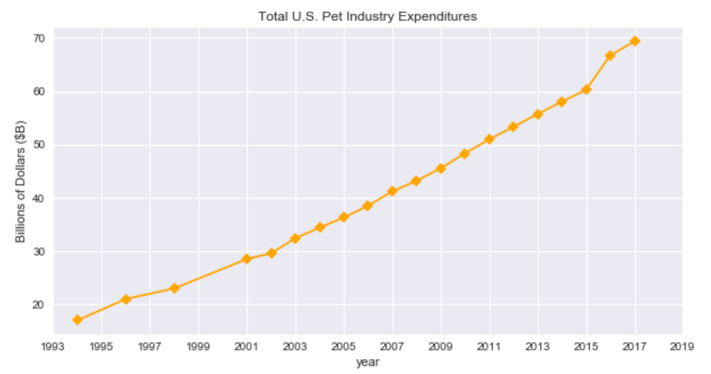
Pet Industry, Best Industry
http://www.americanpetproducts.org/press_industrytrends.asp

Slide 3
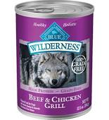

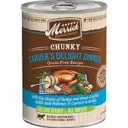
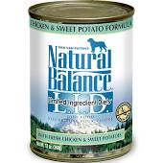
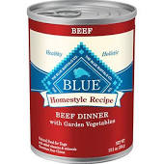
Aims & Objectives
Canned Dog Food
Analysis & Insights :
Market Share
Product Segments
Product User Ratings
Product Marketing

Slide 4
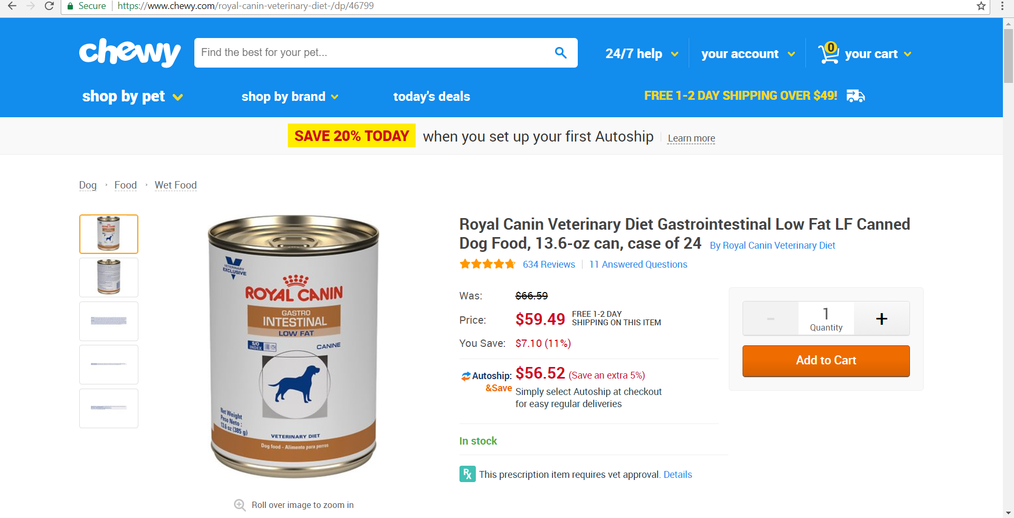
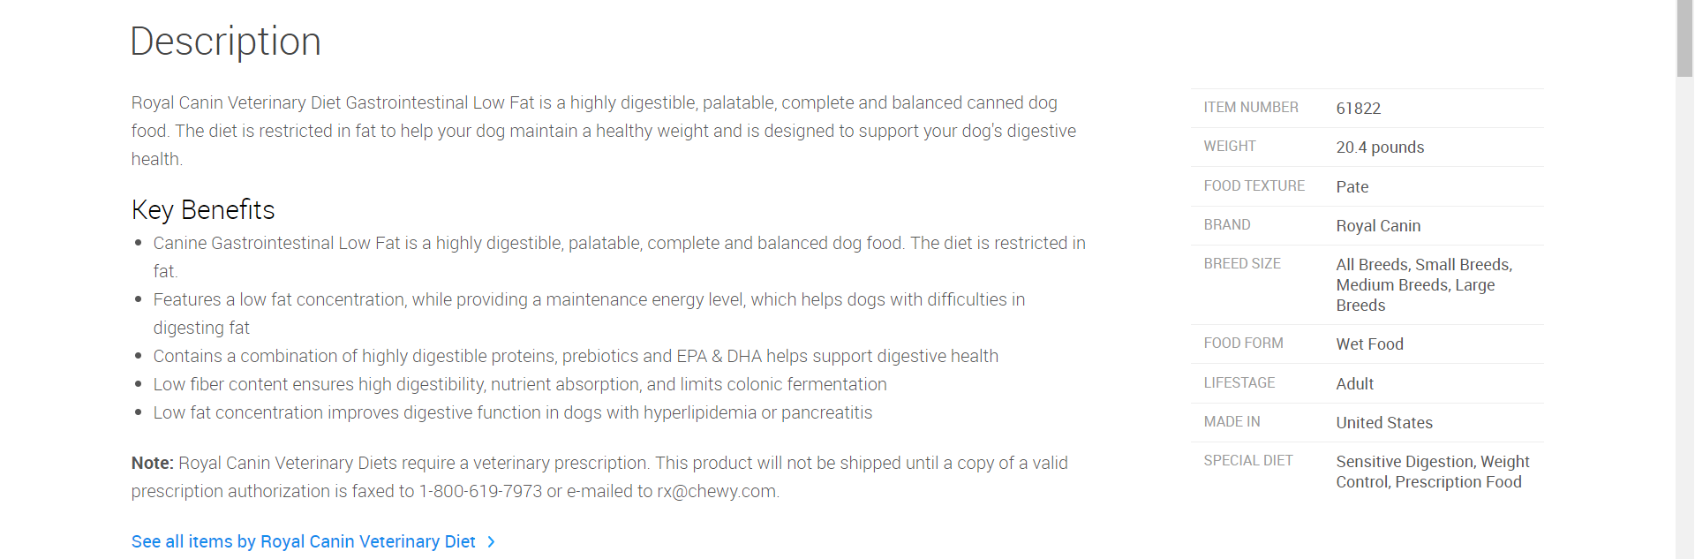
Web Scraping with Scrapy
Product title, Maker
Rating, Number of Reviews
Price
Product Details
Key Benefits

Slide 5
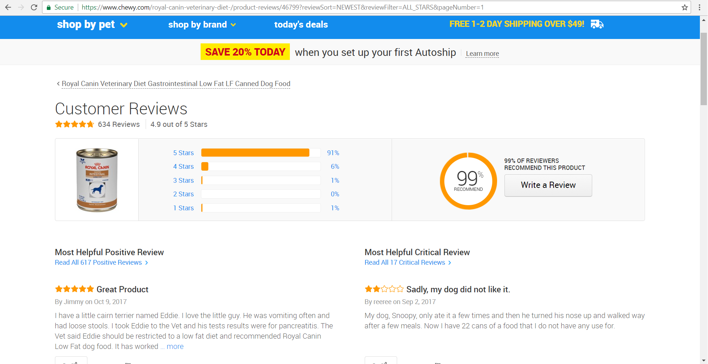
Product Reviews
Review Title & Contents

Slide 6
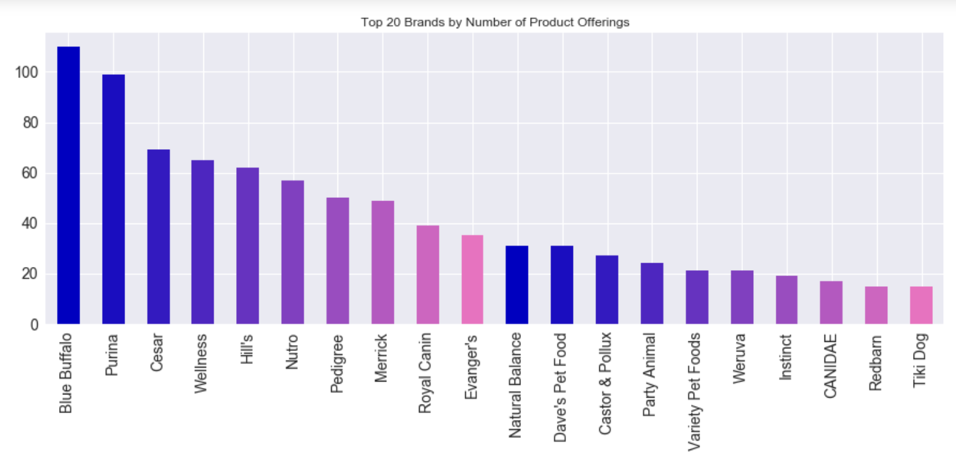
The Biggest Brands

Slide 7
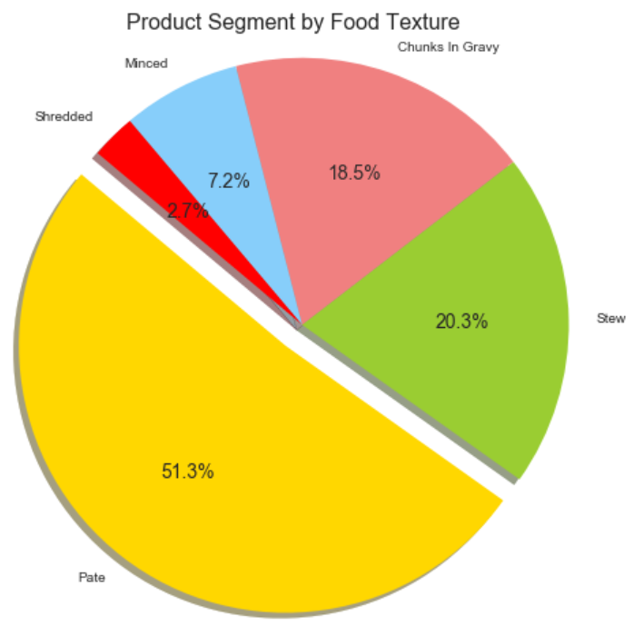
Popularity by Textures

Slide 8


Ratings / Number of Reviews Conundrum
Which is the BETTER Choice ?

Slide 9
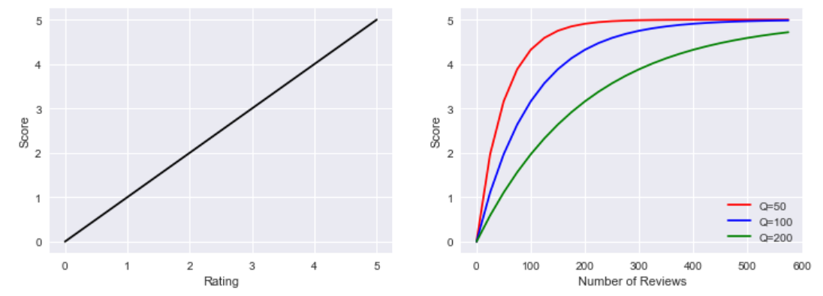
Formulated Score
+
Score=Rating + 5*(1−e^{(Reviews/Q)})
where Q is a tuning constant
(Score : 0 - 10)

Slide 10
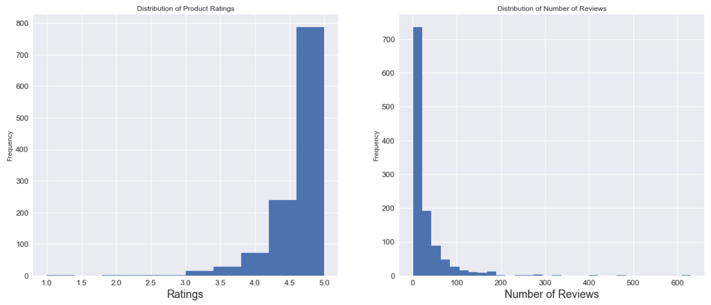
Average Ratings & Reviews
Ratings: 0 – 5
Reviews: 0-600+

Slide 11
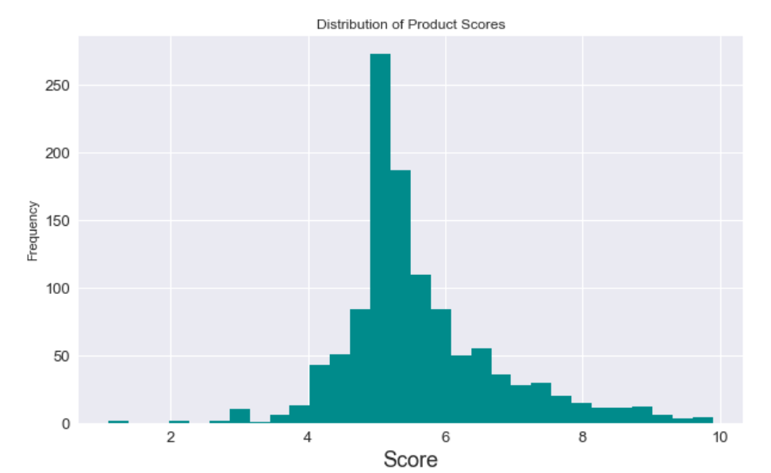
Score Distribution

Slide 12
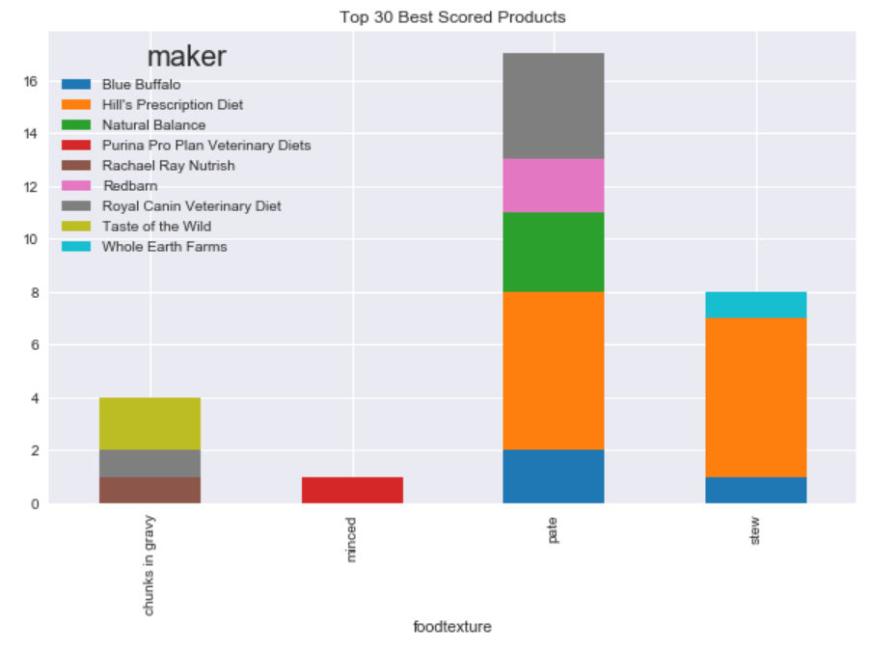
Cream of the Crop

Slide 13
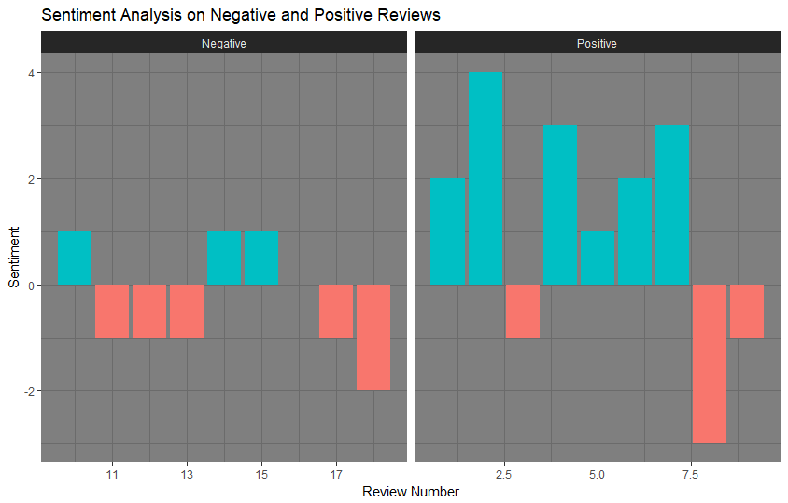
Sentiment Analysis
CSV

Slide 14
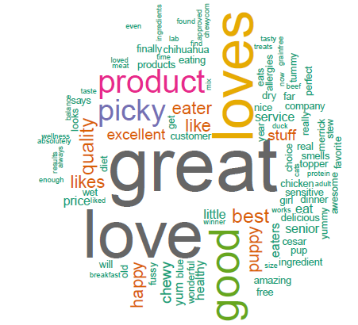
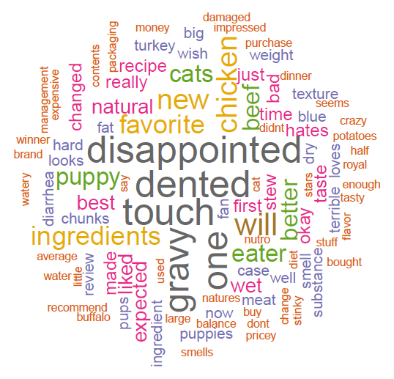
Reviews
Positive
Negative

Slide 15
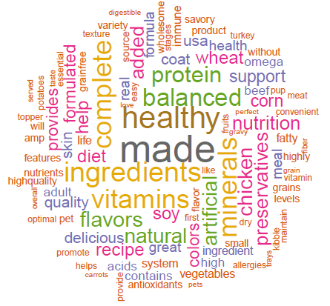
Key Benefits by Producers

Slide 16
Datasets
1289 Rows (Products), 10 Columns
Product Detail Scrape (Local)
Product Detail Scrape CSV (Git)
585 (Rows) Products Reviews, 4 Columns
Product Reviews Scrape CSV (Local)
Product Reviews Scrape CSV (Git)

